Slide 1
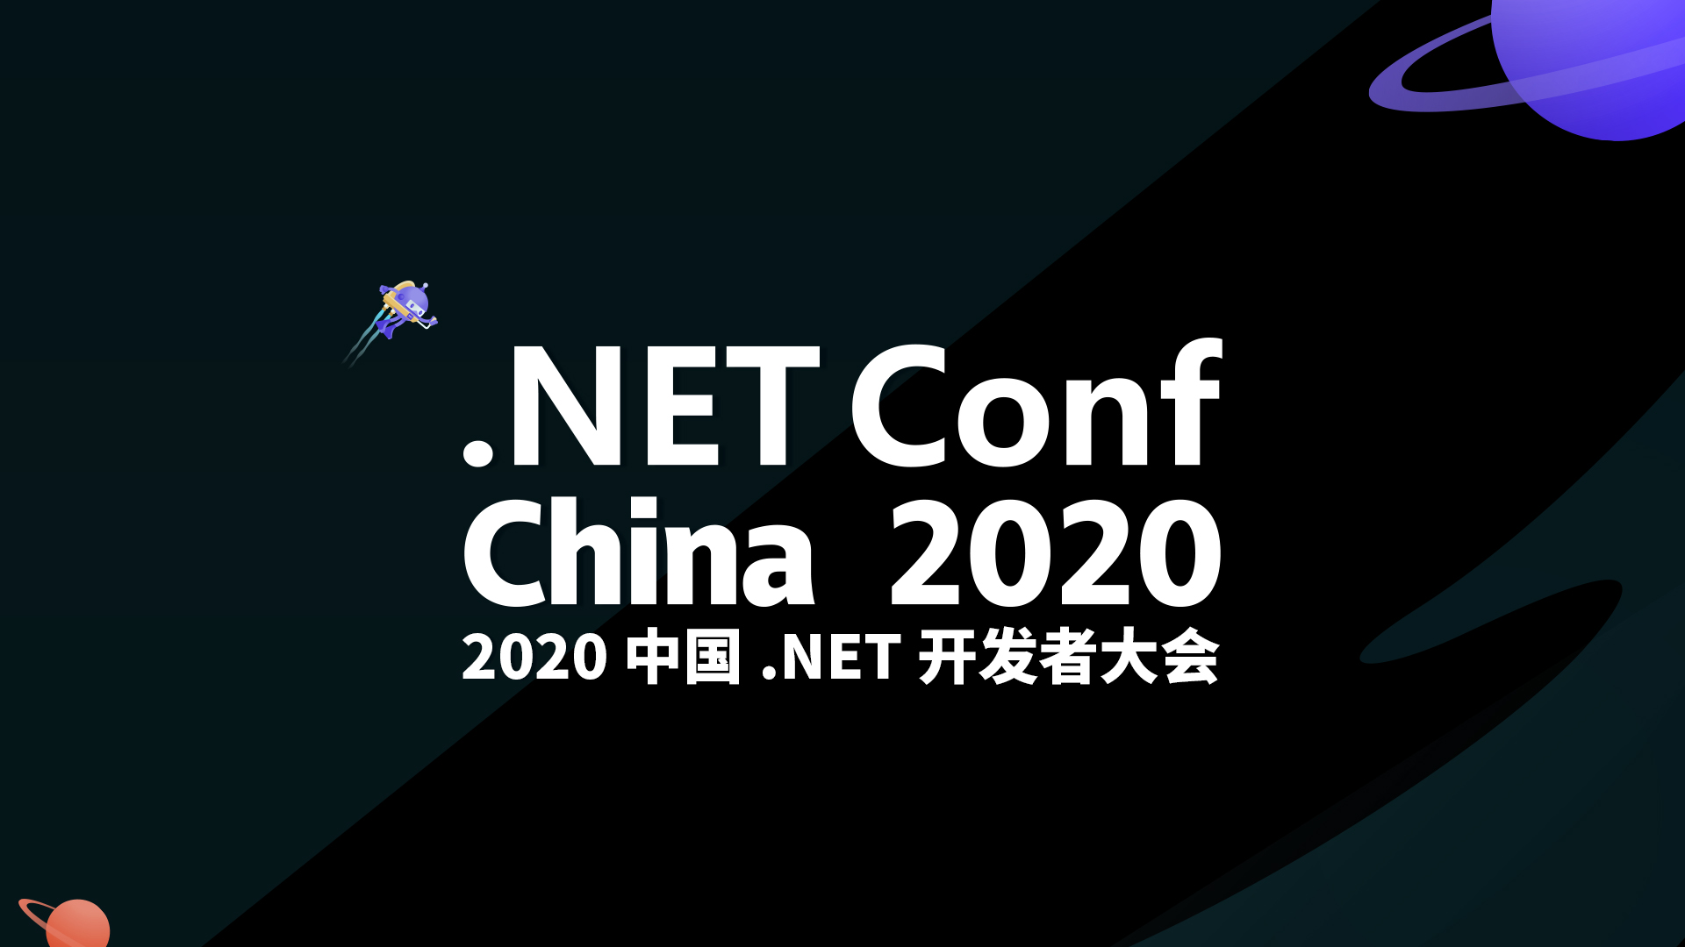

Slide 2

Building Serverless Application With Azure Functions
Li Yu (李宇)
ThoughtWorks – Consultant
2020-12-19

Slide 3
Pre-Request
Building Serverless Application With Azure Functions
Visual Studio Code & Azure Tools Extension
Install Azure Functions Core Tools
Azure [Free] Account
.net core sdk (3.1.x+)
https://github.com/Asinta/ServerlessApp_NetconfChina2020

Slide 4
Building Serverless Application With Azure Functions
What’s in this workshop?
Introduction to Azure Functions.
Build a Azure Functions App to aggregate infos and notify you from scratch using .net core.
Through this workshop, you will…
Know what Azure Functions is and what can it do.
Be able to start your own Azure Functions App quickly.
Explorer more possibilities with Azure Functions.

Slide 5
Building Serverless Application With Azure Functions
Multiple Triggers / Input / Output Bindings (custom bindings enabled)
Multiple Develop Languages
Extremely Cheap

Slide 6





What are we going to build?
Building Serverless Application With Azure Functions

Slide 7
Roadmap
Building Serverless Application With Azure Functions
Create Azure Functions App
Create local project
Add first function
Add second function
Refactor the code
Publish
Clean up

Slide 8
Create Azure Functions App
Building Serverless Application With Azure Functions
Create Azure Functions App
Resource group
Storage account
Azure Functions App

Slide 9
Check it out on Azure Portal!
Building Serverless Application With Azure Functions

Slide 10
Create local project
Building Serverless Application With Azure Functions
Create Azure Functions App
Create local project
init project
new function
config settings

Slide 11
Add first function
Building Serverless Application With Azure Functions
Create Azure Functions App
Create local project
Add first function

Slide 12
Add second function
Building Serverless Application With Azure Functions
Create Azure Functions App
Create local project
Add first function
Add second function

Slide 13
Refactor the code
Building Serverless Application With Azure Functions
Create Azure Functions App
Create local project
Add first function
Add second function
Refactor the code
Separate settings from hard-coding
Use KeyVault to store sensitive data

Slide 14
Check it out on Azure Portal!
Building Serverless Application With Azure Functions

Slide 15
Publish
Building Serverless Application With Azure Functions
Create Azure Functions App
Create local project
Add first function
Add second function
Refactor the code
Publish

Slide 16
Showcase(fan che) Time!
Building Serverless Application With Azure Functions

Slide 17
Clean up
Building Serverless Application With Azure Functions
Create Azure Functions App
Create local project
Add first function
Add second function
Refactor the code
Publish
&
Monitor
Clean up

Slide 18
That’s complete our workshop!
Building Serverless Application With Azure Functions
Create Azure Functions App
Create local project
Add first function
Add second function
Refactor the code
Publish
Clean up

Slide 19
Summary
Building Serverless Application With Azure Functions
create an Azure Functions App using azure cli;
create functions to respond to certain triggers and binding to certain output using .net core;
configure app settings to keep code clean;
retrieve secrets from Azure KeyVault service;
publish local project to Azure;
monitor your app running.

Slide 20






What’s more about Azure Functions…
Building Serverless Application With Azure Functions
$
Application Insights
Cost Management
Security Control
Azure DevOps
EventGrid
API Management

Slide 21


Thank You!

